Slide 1
Top New Technologies in ai
ARCHANA G S
NSTI CALICUT

Slide 2

Introduction
In 2024, AI is rapidly advancing with notable technologies such as generative AI for content creation, AI-driven healthcare innovations like protein folding predictions and gene editing, and powerful exascale computing for complex simulations. Additionally, AI is enhancing geothermal energy systems and environmental monitoring, demonstrating its vast potential to transform industries and address global challenges​

Slide 3

What is ai
Artificial intelligence (AI) refers to the simulation of human intelligence in machines designed to think and act like humans. These machines are programmed to perform tasks such as learning, reasoning, problem-solving, perception, and language understanding.

Slide 4
Artificial intelligence technologies

Slide 5
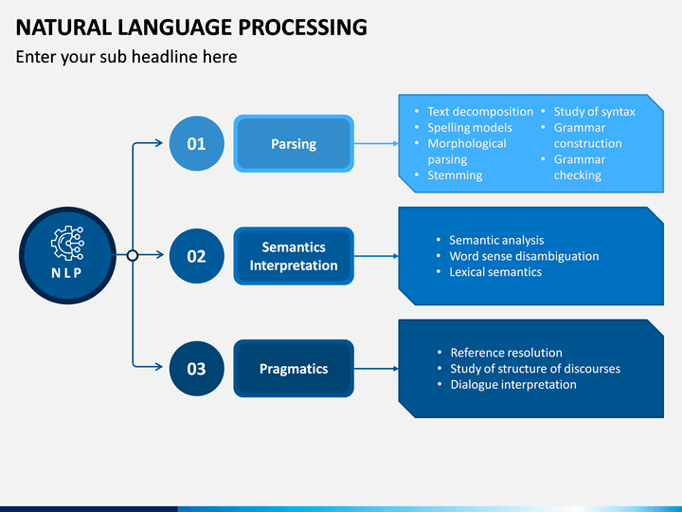
Natural Language Processing (NLP):
This involves the ability of machines to understand, interpret, and respond to human language in a valuable way. Examples include chatbots, language translation services, and sentiment analysis tools

Slide 6
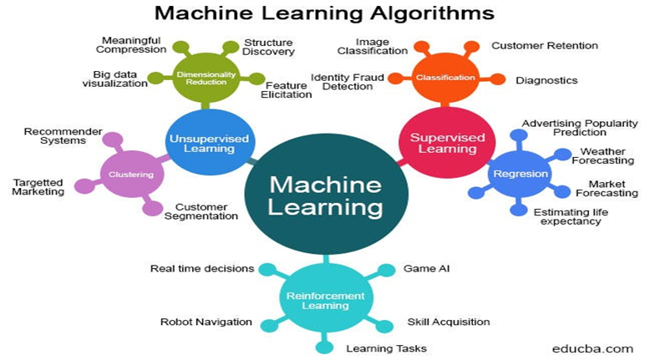
Machine Learning (ML):
A subset of AI where machines learn from data to make predictions or decisions without being explicitly programmed. Common techniques include supervised learning, unsupervised learning, and reinforcement learning

Slide 7
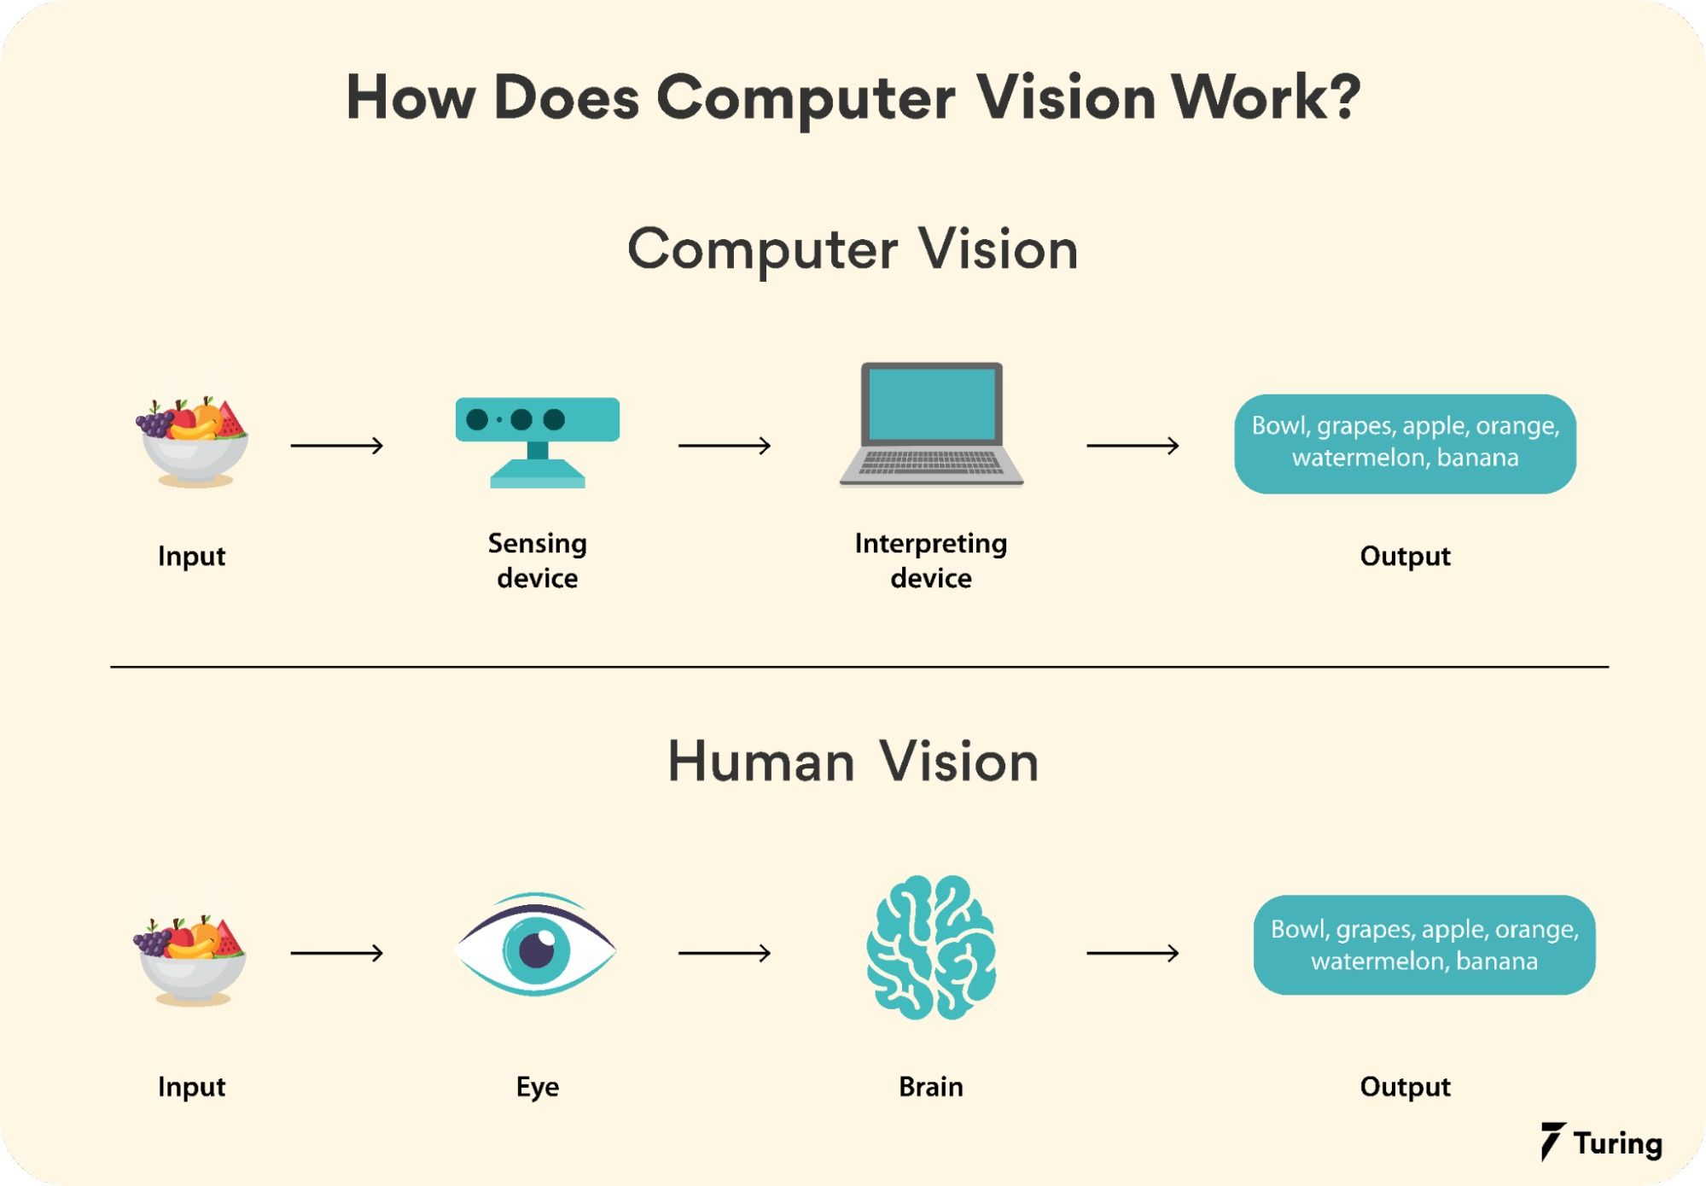
Computer Vision:
The capability of machines to interpret and make decisions based on visual data from the world. Applications include facial recognition, object detection, and autonomous vehicles​

Slide 8
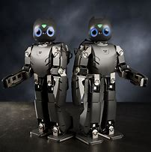
Robotics:
The design and use of robots for performing tasks traditionally done by humans. AI in robotics involves using algorithms for navigation, manipulation, and interaction with the environment​

Slide 9
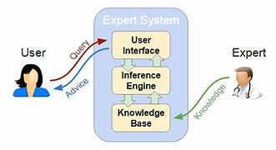
Expert Systems:
AI systems that mimic the decision-making abilities of a human expert, used in fields like medical diagnosis and financial forecasting.

Slide 10
conclusion
AI and associated technologies are fundamentally reshaping our world, revolutionizing industries and daily life. With responsible innovation, we can harness their potential to address challenges and empower humanity, ensuring a future where technology uplifts us all.

Slide 11
Thankyou…..

